Slide 1
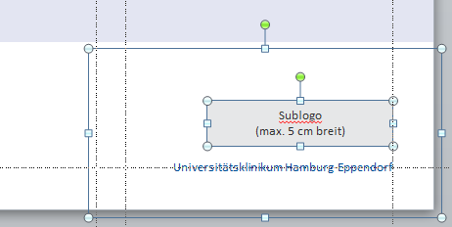
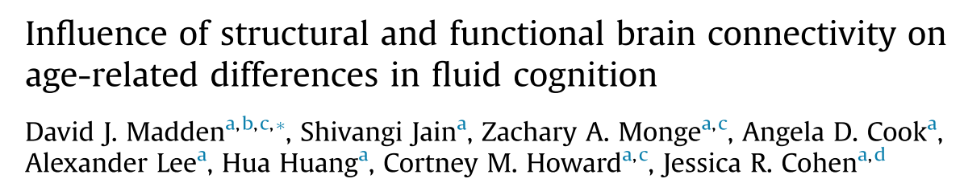
Journal Club
Research
Die Möglichkeit, ein Sublogo zu platzieren, haben Sie auch auf den anderen Titelseiten-Layouts.
Markieren Sie sich hierzu alle Elemente in der unteren rechten Ecke und kopieren Sie sie mit STRG+C.
Gehen Sie auf eines der anderen Titel-Layouts und drücken Sie STRG+V, um die Elemente an gleicher Stelle einzufügen.
Markieren Sie dann das rote Hinweisfeld an der oberen rechten Ecke und löschen es.
(Maximilian Schulz | 21.09.2021)
Universitätsklinikum Hamburg-Eppendorf

Slide 2
Introduction
Fluid cognitive abilities, depending on rapid and flexible coordination of attention and memory, decline during healthy aging, relative to knowledge-based and expertise-based abilities which exhibit age constancy (Craik and Bialystok 2006)
Structural and functional connectivity are statistical mediators of the relation between age and fluid cognition (Li et al., 2020; Madden et al., 2017)
Age related decline in structural connectivity is consistent across studies, functional connectivity between cortical regions rely on multiple white matter pathways (Damoiseaux and Greicius, 2009) and increases and decreases in FC have been observed with age in different regions (Betzel et al., 2014; Biswal et al., 2010…
In younger adults' structural connectivity seems to constrains FC (Greicius et al., 2009)
Networks of structural and functional connectivity diverge especially in higher-order association cortical regions (Batista-García-Ramó and Fernández- Verdecia, 2018) and under best circumstances, structural connectivity accounts for 50% of the variance in FC (Suarez et al., 2020)

Slide 3
Positive relation between functional connectivity and regional white matter integrity (fractional anisotropy; FA) for older adults (Zimmerman et al. 2016) and specific pattern of structural-functional connectivity coupling predicted age more reliably than did either form of connectivity alone (Fjell et al. 2016)
FC within anatomically defined white matter tracts was not consistently higher than FC to regions outside of the tract (Fjell et al. 2017)
Cross-sectional age-affected trajectories differed for structural and functional connectivity, and these measures changed in a largely independently across a 3.3 years longitudinal span (Fjell et al. 2017)
Functional connectivity between modules is better preserved as a function of age than within-module connectivity
particularly for modules in association cortex and more prominent for individuals over 50 years of (Chong et al. 2019 Chan et al. 2014)
Functional modules become less distinct or separate with increasing age, expressed in graph theoretical terms as decreased modularity and system segregation, based on measures of within-module and between-module connectivity (Bagarinao et al., 2019; Betzel et al., 2014)
Graph theoretical investigations of resting-state FC support concept of age-related neural dedifferentiation, the idea that aging is associated with a decline in the specialization or separation of functional neural modules (Geerligs et al., 2014)

Slide 4
Graph theoretical investigations of age-related differences in brain structure consistently report age-related decline in structural connectivity, with variation in strength and efficiency (Gong et al., 2009)
E.g. structural global efficiency declined with age to a greater extent than local efficiency, and fewer between-module connections were evident in the older adults, yielding a more localized and segregated network (Zhao et al. 2015)
Nodes with direct structural connections exhibit little age-related change in functional connectivity, nodes with less efficient structural connections were more likely to exhibit an age-related increase in FC Betzel et al. (2014)
Age-related decrease in functional system segregation may be a result of decreased structural efficiency, with functional connections between structurally disconnected regions relying on indirect paths
Hypothesis:
Increasing age, functional modules tend to become less distinct >> Functional system segregation would decrease with age
Functional system segregation would have a mediating influence on the negative relation between age and fluid cognition
Structural connectivity would constrain the influence of functional connectivity on the age-cognition relation

Slide 5
Participants
143 healthy community-dwelling adults (19-79 years)
All participants were right-handed, had completed at least 12 years of education, did not report any major health issues
Cognitive measures
The cognitive outcome measures comprised 9 tests of fluid cognition
targeted 3 domains: elementary perceptual speed, executive function, and memory, with 3 indicator variables per domain
Study specific anatomical template
T1 brain image from all 143 participants
Individual T1 brain was warped to this starting point average brain
These individually warped T1 images were merged together to create a new averaged template
starting point for the next iteration of warping individual T1 images till the mean image converged, yielding the final study-specific template.

Slide 6
Parcellation
(Journal Club)
anatomical Harvard-Oxford Atlas registered to the study-specific template resulting in weighted connectivity matrix of 397x 397 ROIs
Structural:
Number of streamlines between all pairs of ROIs
Functional:
Normalized times series along slice volumes for all voxels, Pearsons r correlation transformed to Fisher-z
Negative correlations, negatively weighted edges and diagonal to zero
Modules
Averaged connectivity matrices of all participants to obtain a single structural matrix and a single functional matrix
Modules in a data-driven manner, within the structural and functional domains with the Louvain algorithm of the Brain Connectivity Toolbox with a gamma value at 1.15 and 150 runs
Thresholding agreement matrices at 0.50, thus retaining values for only those pairs of nodes that were assigned to the same module at least 50% of the time
The averaged connectivity matrices comprising the 8 structurel modules and 6 functional modules

Slide 7
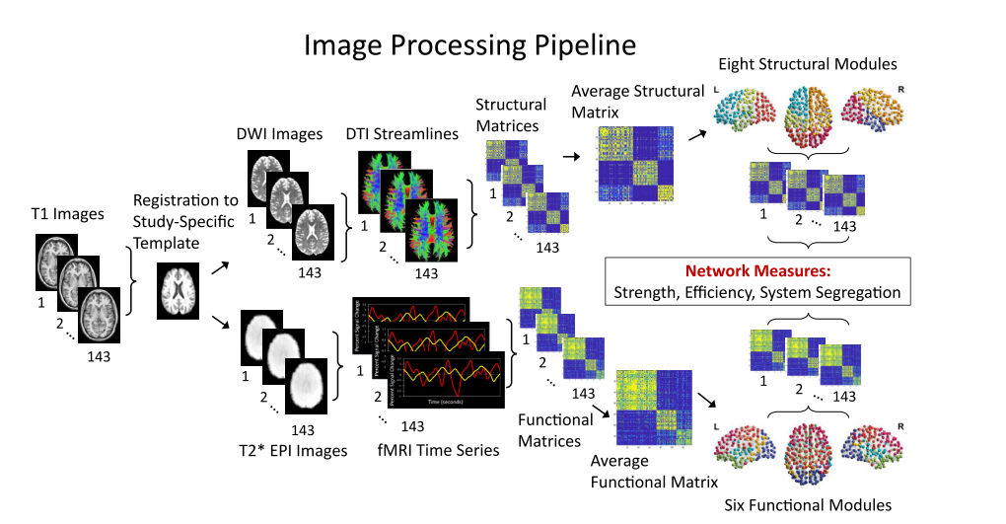
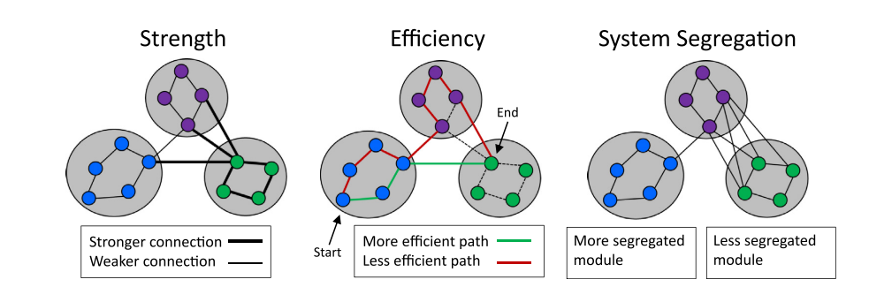

Parameters
Global efficiency, local efficiency
Strength:
Global average strength represents the strength of the connection of each node to every other node in the brain
Between module strength
Within module strength
System segregation:

Slide 8
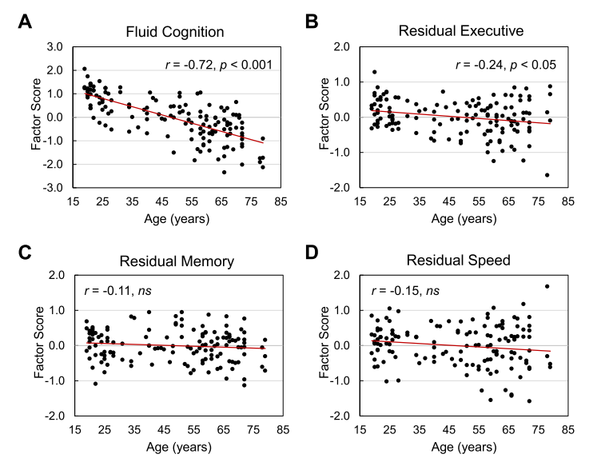
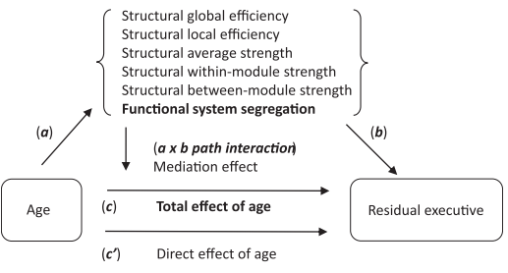
Results - global
General linear model of cognition and age
Fluid cognition as a whole and executive function declined with age
General linear model of graph parameters and age
Structural
Global efficiency
Local efficiency
Average strength
Within-module strength
Between-module strength
Functional
System segregation
Mediation models
Age as predictor, and the outcome variable was either overall fluid cognition (Model 1) or residual executive function (Model 2)
Potential mediators were the network-property measures that varied significantly with age

Slide 9
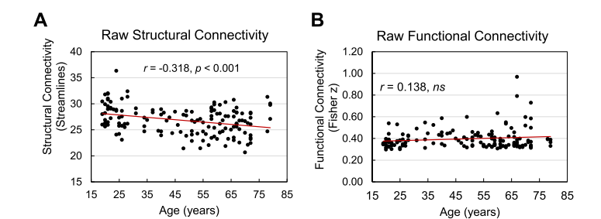
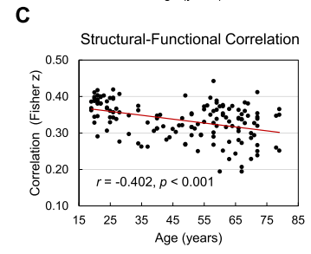
Results
Structural-functional interaction
Mediation model structural measures were potential mediators of the relation between age and functional system segregation
None was significant mediator, and none exhibited an age independent relation to functional system segregation
Relation between structural and functional connectivity in the raw matrix
Correlation of the fMRI time series associated with streamlines did not exhibit age-related decline
Pearson r correlation between structural connections (i.e., number of streamlines) and the functional connectivity in the corresponding cells of the functional connectivity matrix declined with age.
General linear model of graph parameters and age for modules
Right frontal module: age-related effects for average strength, within-module strength, and system segregation.
Left occipito-parietal module: age-related decline in between-module strength and an age-related increase in system segregation
Occipitoparietal module: age-related decline in functional system segregation

Slide 10
Discussion
Hypothesis:
functional system segregation would decrease with age
functional system segregation would be a significant mediator of age-related decline in fluid cognition
structural connectivity would constrain the influence of functional connectivity on the age-cognition relation
Decline in system segregation is specific to functional connectivity and is not a feature of structural connectivity
Specific contribution from the occipito-parietal module to the age-related decline in system segregation
System segregation, has a mediating role in age-related cognitive decline. The relation of age to residual executive function was indirect, operating through functional system segregation.
Specific regional effects of structural connectivity with prominent contributions from the right frontal module
Structural connectivity provided a measurable though relatively weak constraint on age-related differences in functional connectivity

Slide 11
Klinik, Institut, Geschäftsbereich
Martinistraße 52 | D-20246 Hamburg
Ansprechpartner
Telefon +49 (0) 15202781606 m.schulz1@uke.de | www.uke.de

